Slide 1
Advanced Database Systems
Winter Semester
Week 2- Part One (RAID Systems, Failvote, Message Passing)
Ahmad

Slide 2
Question 1
Which of the following RAID configurations that we saw in class has the lowest disk space utilization? Your answer needs to have explanations with calculations for each case.
(a) RAID 0 with 2 disks
(b) RAID 1 with 2 disks
(c) RAID 3 with 3 disks
Where does this lack of utilization of space go, i.e., where we can use such a configuration as it has some benefits gained due to the loss of space utilization?

Slide 3
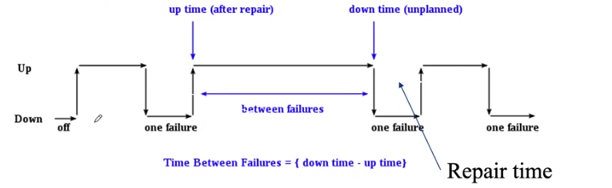

A review
Mean time to failure:
  Definition
    The time elapsed before a failure occurs.
  Show it on the Graph?
  If $p$ is the probability of failure, how MTTF it calculated?
    $1/p$
MTTF

Slide 4
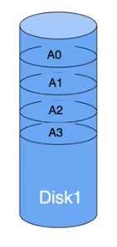

(Review) Baseline: One Disk
MTTF: $1/p$
  $p$: probability of failure of disk
  $MTTF\left(disk\right)=\frac{1}{p}$

Slide 5
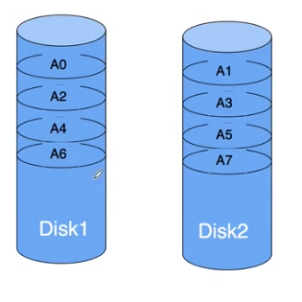
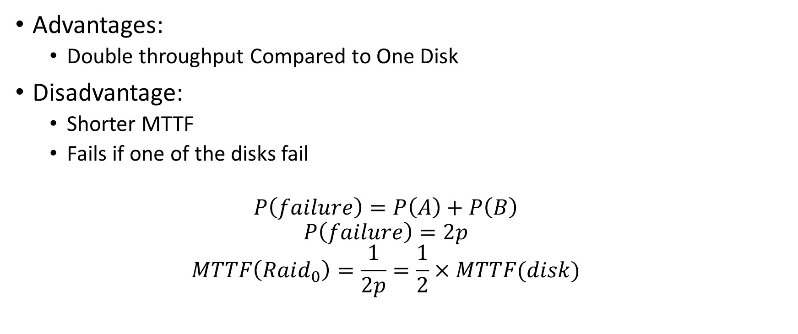
(Review) Raid 0: Separated Storage
Advantages:
  Double throughput Compared to One Disk
Disadvantage:
  Shorter MTTF
  Fails if one of the disks fail
  $$P\left(failure\right)=P\left(A\right)+P\left(B\right)$$
  $$P\left(failure\right)=2p$$
  $$MTTF\left(Raid_{0}\right)=\frac{1}{2p}=\frac{1}{2}×MTTF(disk)$$

Slide 6
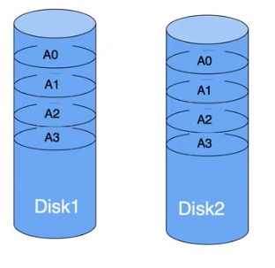
Raid 1: Mirrored Storage
Data is mirrored across the two storages
Disadvantages:
  Double Storage
Advantages: Better Fault Tolerance
  How much better?

Slide 7
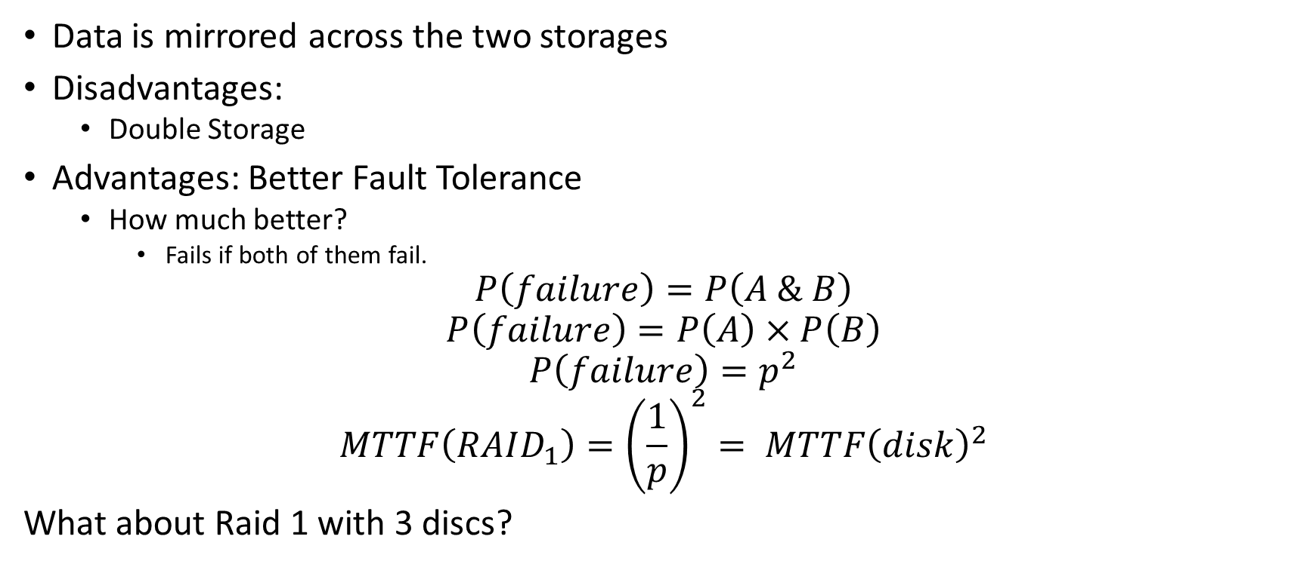
Raid 1: Mirrored Storage
Data is mirrored across the two storages
Disadvantages:
  Double Storage
Advantages: Better Fault Tolerance
  How much better?
    Fails if both of them fail.
$$P\left(failure\right)=P\left(A \& B\right)$$
$$P\left(failure\right)=P\left(A\right)×P\left(B\right)$$
$$P\left(failure\right)=p^{2}$$
$$MTTF\left(RAID_{1}\right)={\left(\frac{1}{p}\right)}^{2}= MTTF{\left(disk\right)}^{2}$$
What about Raid 1 with 3 discs?

Slide 8
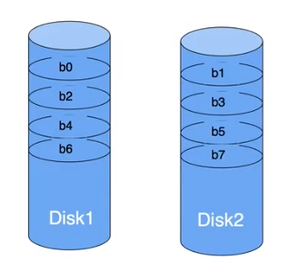
Raid 2: Bit-level separation
Similar to Raid 0, but stores data at the bit level.
Advantages:
  Higher transfer rate
Disadvantages
  Rarely used
  what about MTTF?

Slide 9
Raid 2: Bit-level separation
Similar to Raid 0, but stores data at the bit level.
Advantages:
  Higher transfer rate
Disadvantages
  Rarely used
  what about MTTF?
    Is same as the one for Raid 0.

Slide 10
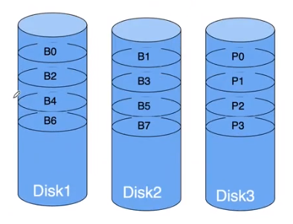
Raid 3:Byte Parity Raid
Data stored separately, and a separate parity bit is also stored for each bit
Advantages:
  Higher transfer rate than Raid 0.
Disadvantages:
  Rarely used.
What is the MTTF?
  Breakout rooms.

Slide 11
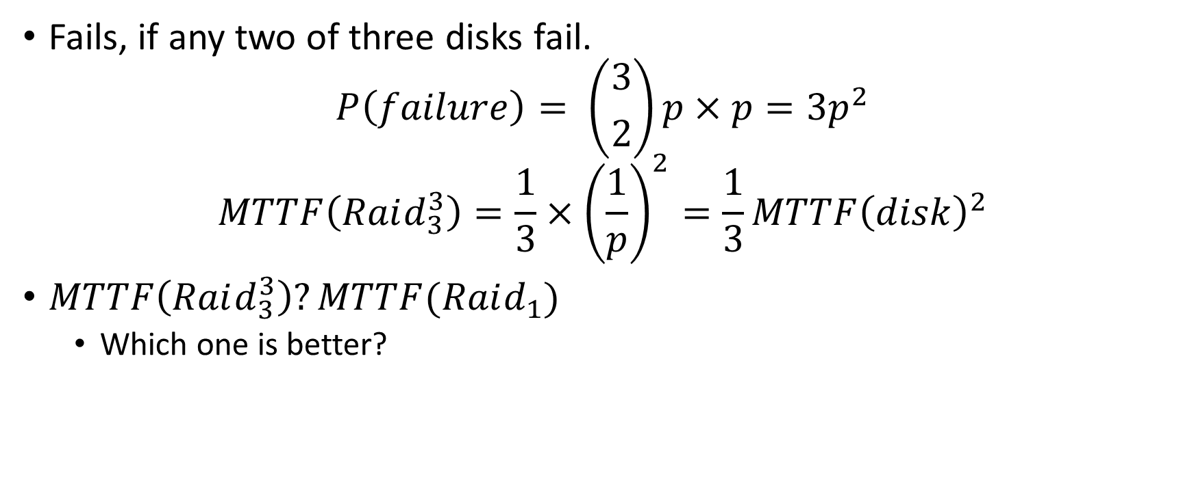
Raid 3:Byte Parity Raid (MTTF)
Fails, if any two of three disks fail.
$$P\left(failure\right)= \left({3 \atop 2}\right)p×p=3p^{2}$$
$$MTTF\left(Raid_{3}^{3}\right)=\frac{1}{3}×{\left(\frac{1}{p}\right)}^{2}=\frac{1}{3}MTTF{\left(disk\right)}^{2}$$
$MTTF\left(Raid_{3}^{3}\right)?MTTF(Raid_{1})$
  Which one is better?

Slide 12

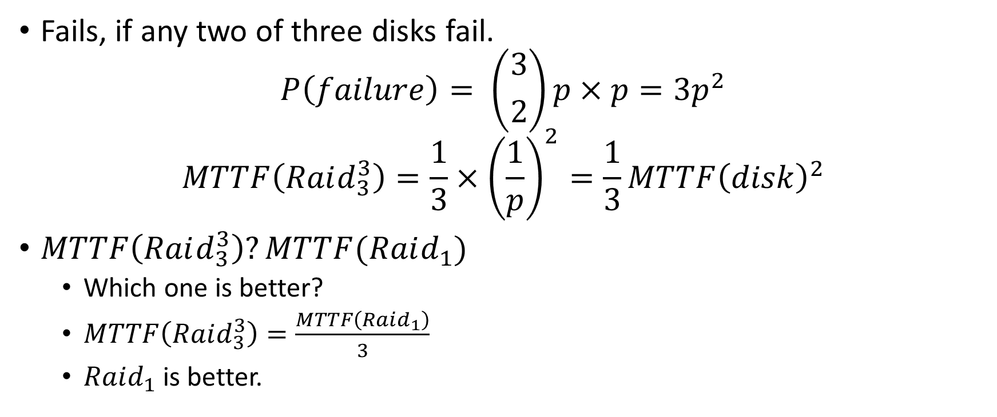
Raid 3:Byte Parity Raid (MTTF)
Fails, if any two of three disks fail.
$$P\left(failure\right)= \left({3 \atop 2}\right)p×p=3p^{2}$$
$$MTTF\left(Raid_{3}^{3}\right)=\frac{1}{3}×{\left(\frac{1}{p}\right)}^{2}=\frac{1}{3}MTTF{\left(disk\right)}^{2}$$
$MTTF\left(Raid_{3}^{3}\right)?MTTF(Raid_{1})$
  Which one is better?
  $MTTF\left(Raid_{3}^{3}\right)=\frac{MTTF\left(Raid_{1}\right)}{3}$
  $Raid_{1}$ is better.

Slide 13
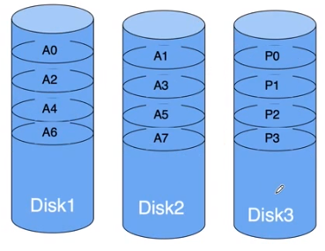
Raid 4
Similar to Raid 3, but stored at Block Level
Advantages:
  Higher throughput.
Disadvantages:
  Very slow writes
    Disk 3 has more writes, as parity needs to be updated.
    How to handle this?
What is the MTTF?

Slide 14
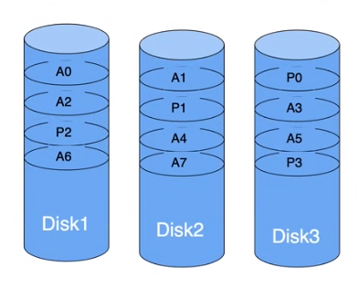
Raid 5
Similar to Raid 4, but Parity is distributed among all disks.
Advantages:
  Higher Throughput
  Better write speed compared to Raid 4
What is the MTTF for Raid 5?

Slide 15
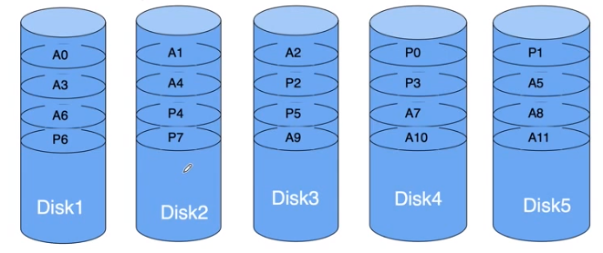
Raid 6:
Extension of Raid 5 with two more disks
Parities are stored in a way to insure recovery in the case of two failures.
Advantages:
  Higher Throughput
  Longer MTTF
What is MTTF?

Slide 16

Raid 6: MTTF (Breakout rooms)
$$P\left(Failure\right)=P\left(A\&B\&C\right)+P\left(A\&B\&D\right)+ …$$
$$P\left(Failure\right)=\left({5 \atop 3}\right)p^{3}=10p^{3}$$
$$MTTF=\frac{1}{10}×{\left(\frac{1}{p}\right)}^{3}=\frac{1}{10}MTTF{\left(disk\right)}^{3}$$

Slide 17
Question 1
Which of the following RAID configurations that we saw in class has the lowest disk space utilization? Your answer needs to have explanations with calculations for each case.
(a) RAID 0 with 2 disks
(b) RAID 1 with 2 disks
(c) RAID 3 with 3 disks
Where does this lack of utilization of space go, i.e., where we can use such a configuration as it has some benefits gained due to the loss of space utilization?

Slide 18
Question 1- Solution
(a) RAID 0 with 2 disks
  In case 1, the space utilization is 100% because the two disks store contiguous blocks of a file in RAID 0.
(b) RAID 1 with 2 disks
  In case 2, the space utilization is 50% because RAID 1 uses mirroring. MTTF increases so for cases where a disk can fail easily this is good. The system operates even when a disk fails.
(c) RAID 3 with 3 disks
  In case 3, the space utilization is (3-1)/3=66.7 because RAID 3 uses one disk for storing parity data.
Therefore case 2 has the lowest disk utilization.

Slide 19
Question 2
We start with question 2. What is the mean time to failure value for different RAID systems, please review/discuss?
a. RAID 0 with 2 disks
b. RAID 2 with 2 disks
c. RAID 1 with 2 disks
d. RAID 1 with 3 disks
e. RAID 3 with 3 disks
f. RAID 4 with 3 disks
g. RAID 5 with 3 disks
h. RAID 6 with 5 disks

Slide 20
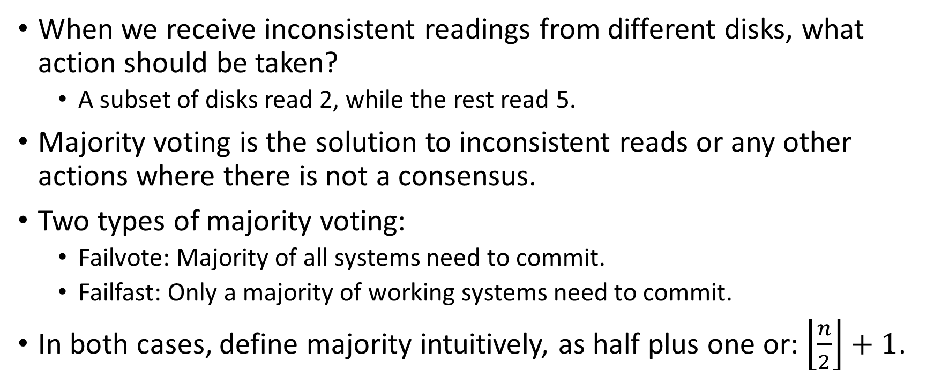
Voting when failure happens
When we receive inconsistent readings from different disks, what action should be taken?
  A subset of disks read 2, while the rest read 5.
Majority voting is the solution to inconsistent reads or any other actions where there is not a consensus.
Two types of majority voting:
  Failvote: Majority of all systems need to commit.
  Failfast: Only a majority of working systems need to commit.
In both cases, define majority intuitively, as half plus one or: $\left\lfloor \frac{n}{2}\right\rfloor +1$.

Slide 21
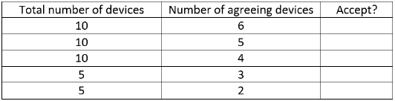
Question 3
In a Failvote system, in which of the following cases can we accept an action?

Slide 22
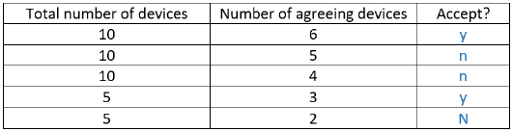
Question 5- Solution
In a Failvote system, in which of the following cases can we accept an action?

Slide 23
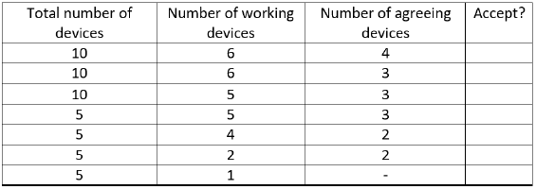
Question 4
In a Failfast system, in which of the following cases can we accept an action?

Slide 24
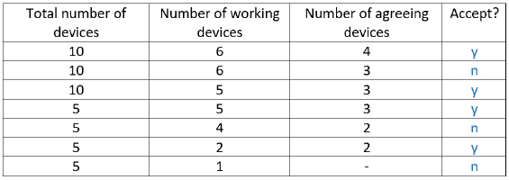
Question 4- Solution
In a Failfast system, in which of the following cases can we accept an action?

Slide 25
Question 5
There are two nodes in a network that use stable storage and acknowledgment message passing for reliable communication. The stable storage of Node A contains the following record - Received message (In6); Transmitted message(Out3); Out:3 Ack:3 In:6. The stable storage of Node B contains the following record - Received message (In3); Transmitted message(Out6); Out:6 Ack:6 In:3.
Now Node B sends a new message 7 to Node A. What will be in the stable storage of A and B if the message is received correctly, including a correctly received acknowledgement?

Slide 26
Solution to Question 5
Node A
Node B
Transmitted (Out 3)
  Out (3)
  Ack (3)
Received (In 6)
  In (6)
Transmitted (Out 6)
  Out (6)
  Ack (6)
Received (In 3)
  In (3)

Slide 27
Solution to Question 5
Now Node B sends a new message 7 to Node A. What will be in the stable storage of A and B if the message is received correctly, including a correctly received acknowledgement?
Node A
Node B
Transmitted (Out 3)
  Out (3)
  Ack (3)
Received (In 7)
  In (7)
Transmitted (Out 7)
  Out (7)
  Ack (7)
Received (In 3)
  In (3)

Slide 28
Question 6
Assume The initial State as of question 3
Now Node B sends a new message 7 to Node A. What will change in the stable storage of A and B if the message is received correctly, but the acknowledgement is not received?

Slide 29
Solution to Question 6
Node A
Node B
Transmitted (Out 3)
  Out (3)
  Ack (3)
Received (In 7)
  In (7)
Transmitted (Out 7)
  Out (7)
  Ack (6)
Received (In 3)
  In (3)

Slide 30
Advanced Database Systems
Winter Semester
Week 2- Part Two (Query Optimization, Nested Loop Join)
Ahmad

Slide 31
Strategies for Query Optimizations
Searching/Enumerating all the plans and choose the best one.
  Used for quires that require accurate results.
  Well suited for handling complex quires.
Using a heuristic approach
  Is like using a solution randomly.
  Is a good option when accuracy is not a priority.
  Can handle simple and straight-forward cases.

Slide 32
Question 7
Which of the query optimization approaches is suitable for the following queries?
Scenario A: (Given a table with 10 million tuples, run a query)
  SELECT customer
  FROM Table
  WHERE spend BETWEEN 100 AND 200
  AND birth_year> 2000
Notes:
For Scenario A, the heuristic approach would be better due to the simplicity of the query and the size of the table.

Slide 33
Question 7-A, Solution
Which of the query optimization approaches is suitable for the following queries?
Scenario A: (Given a table with 10 million tuples, run a query)
  SELECT customer
  FROM Table
  WHERE spend BETWEEN 100 AND 200
  AND birth_year> 2000
Solution: For Scenario A, the heuristic approach would be suitable due to the simplicity of the query.
Notes:
For Scenario A, the heuristic approach would be better due to the simplicity of the query and the size of the table.

Slide 34
Question 7- B
Scenario B: (Given 5 tables with 1000 tuples in each table, run a query)
  SELECT T1.name, T2.salary, T3.qualification, T4.phone, T5.leader
  FROM Table1 T1
    INNER JOIN Table2 T2 ON T2.id = T1.id
    INNER JOIN Table3 T3 ON T3.id = T1.id
    INNER JOIN Table4 T4 ON T4.id = T1.id
    INNER JOIN Table5 T5 ON T5.department = T1.department
  WHERE T1.age > 50;
Notes:
For Scenario B, the enumerating approach would be more suitable due to the complexity of the query even if the size of each table is smaller than the table in Scenario A.

Slide 35
Question 7- B, Solution
Scenario B: (Given 5 tables with 1000 tuples in each table, run a query)
  SELECT T1.name, T2.salary, T3.qualification, T4.phone, T5.leader
  FROM Table1 T1
    INNER JOIN Table2 T2 ON T2.id = T1.id
    INNER JOIN Table3 T3 ON T3.id = T1.id
    INNER JOIN Table4 T4 ON T4.id = T1.id
    INNER JOIN Table5 T5 ON T5.department = T1.department
  WHERE T1.age > 50;
Solution: For Scenario B, the enumerating approach would be more suitable due to the complexity of the query.
Notes:
For Scenario B, the enumerating approach would be more suitable due to the complexity of the query even if the size of each table is smaller than the table in Scenario A.

Slide 36
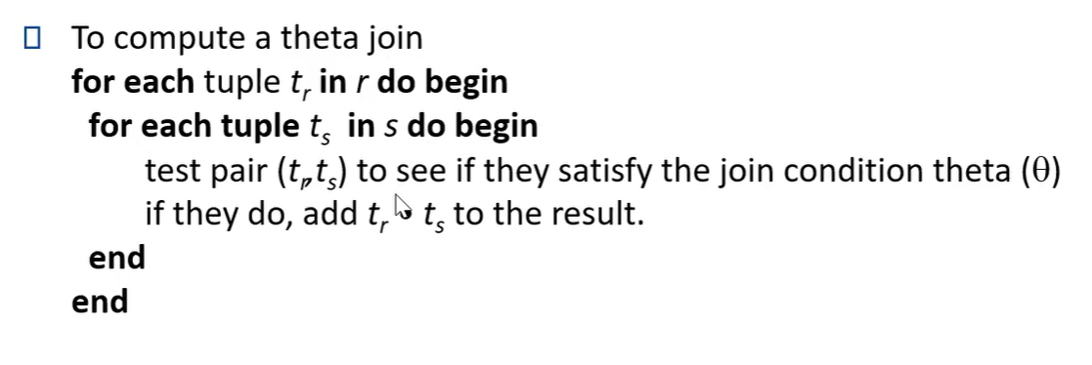

About Nested-Loop Join
The number of block transfers is $n_{r}∗b_{s}$ + $b_{r}$.
The number of seeks is $n_{r}+b_{r}$

Slide 37
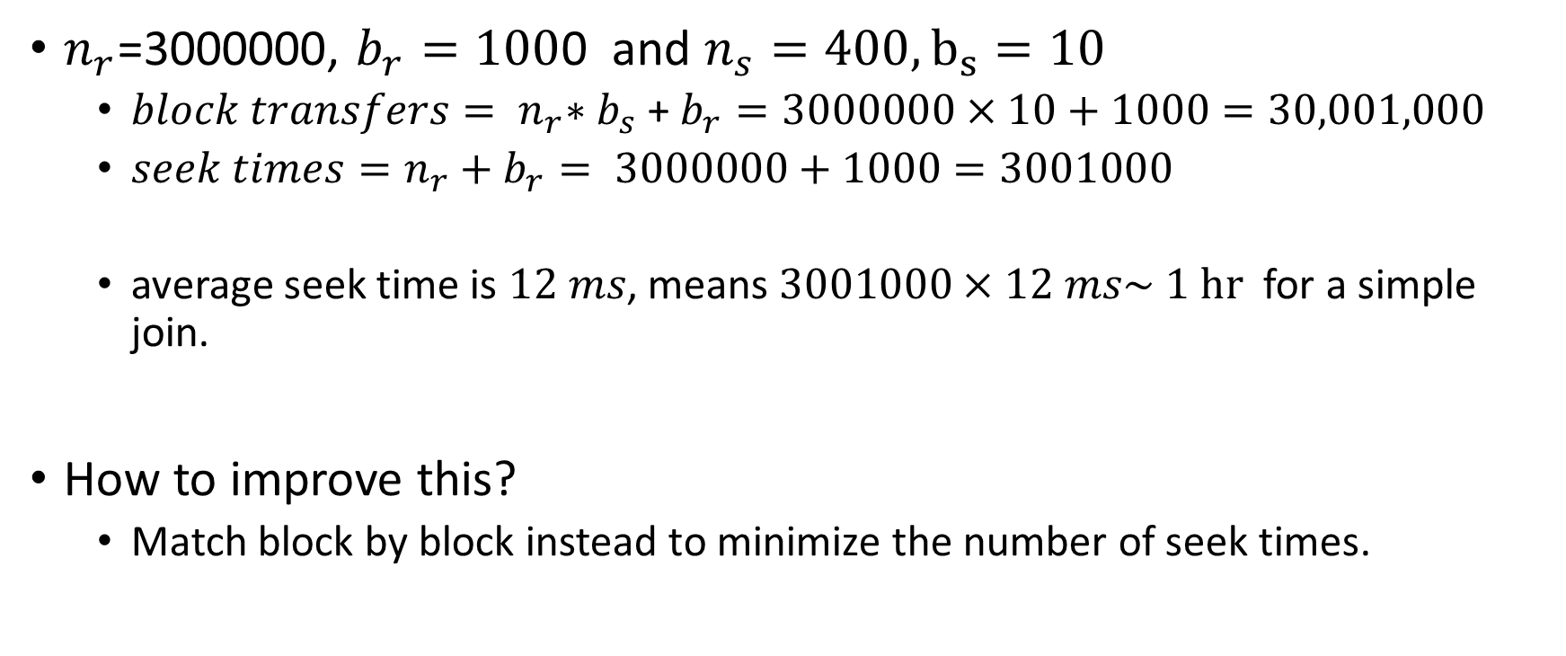
Example with Nested Loop Join
$n_{r}$=3000000, $b_{r}=100$0 and $n_{s}=400, b_{s}=10$
  $block transfers{= n}_{r}∗b_{s}\text{ + }b_{r}=3000000×10+1000=30,001,000$
  $seek times=n_{r}+b_{r}= 3000000+1000=3001000$
  average seek time is $12 ms$, means $3001000×12 ms\sim 1 hr$ for a simple join.
How to improve this?
  Match block by block instead to minimize the number of seek times.

Slide 38
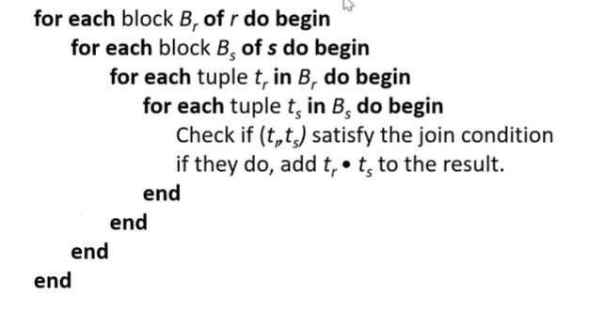

Improved Nested-Join; Block Nested-Join
Number of block transfers: $b_{r}×b_{s}+b_{r}$
Number of seeks: $2×b_{r}$

Slide 39

Example with Block Nested-Loop Join
Number of seeks = $2×b_{r}=2000$
The new seek time is $2000×12 ms \sim 24 seconds$
In orders three orders of magnitude less than the Nested-Loop join.

Slide 40
Question 8
Review the examples on nested-loop join and block nested-loop join given in the lecture. Discuss and calculate why the later one can be more efficient.

Slide 41
Question 8- Solution
Review the examples on nested-loop join and block nested-loop join given in the lecture. Discuss and calculate why the later one can be more efficient.
  After reiterating the examples/calculations, we see the later one is most efficient because each block in the inner relation is read once for each block in the outer relation (instead of once for each tuple in the outer relation)

Slide 42
Question 9
A particular query on table A used to run quite efficiently in a DBMS. After inserting many records and deleting many other records from table A, that same query is now taking more time to run, even when the total number of records has not changed. What can be the reason for that? What can you do as the user/database administrator of that DBMS to improve the performance of this query?

Slide 43
Question 9- Answer
Solution:
After insertions and deletions, the statistics of a table may not be updated instantly. As the statistics are used to estimate the cost of a query, wrong statistics are causing wrong cost estimations, and hence the query optimiser is now choosing a query plan that is no longer optimal for that query.
Enforcing statistical recompilation option can be used to update the statistics of the table.

Slide 44
Advanced Database Systems
Winter Semester
Week 2- Part Three (Data Structures for Big Data)
Ahmad

Slide 45
Are Heuristic and Enumerating the only options?
Systems may use heuristics to reduce the number of choices that must be made in a cost-based fashion
However, DBMS admin generally creates indices to allow almost direct access to individual items
Two basic kinds of indices:
  Ordered indices: search keys are stored in some order
  Hash indices: search keys are distributed hopefully uniformly across “buckets” using a “function”
The impacts:
  Faster disk access; but insertion and deletion is also important.

Slide 46
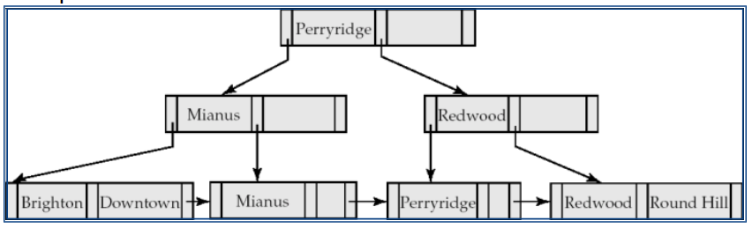
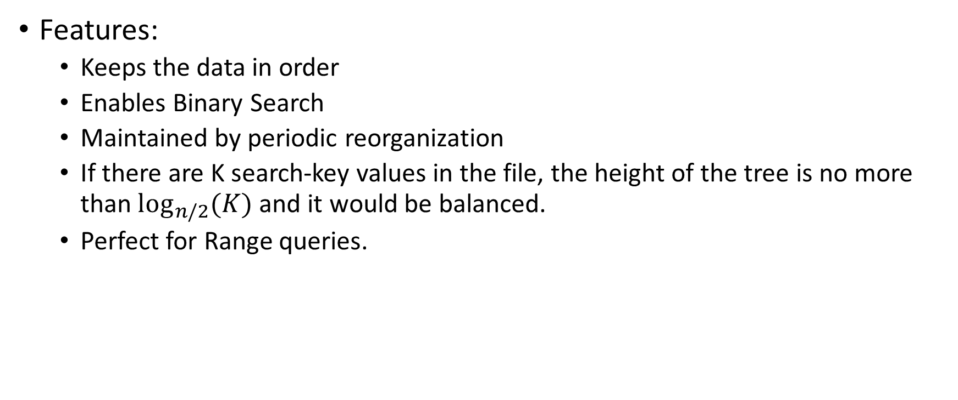
Most Popular Index in DMBS: B+Tree
Features:
  Keeps the data in order
  Enables Binary Search
  Maintained by periodic reorganization
  If there are K search-key values in the file, the height of the tree is no more than $\log_{n/2}(K)$and it would be balanced.
  Perfect for Range queries.

Slide 47
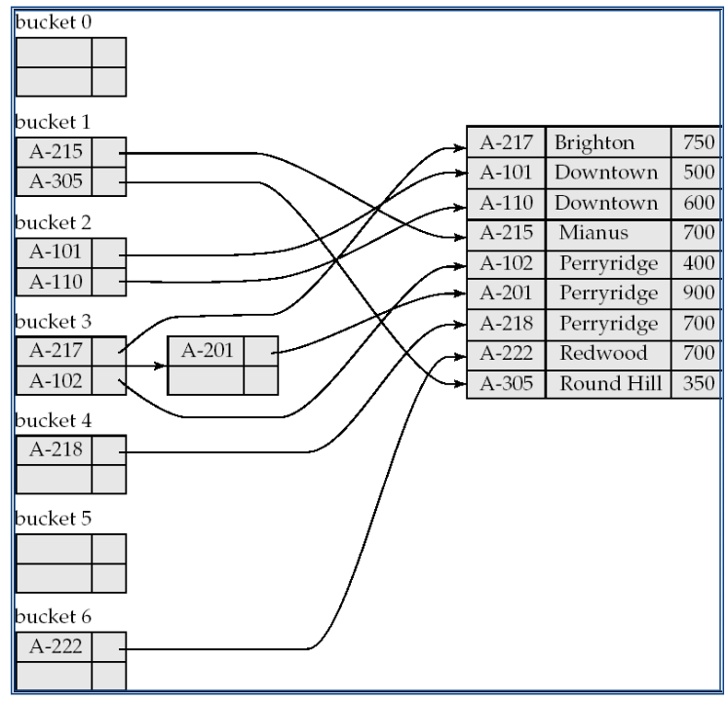
Other forms of indices: Hash Indices
Unordered, but record pointers are used with search keys.
Given a key the aim is to find the related record on file in one shot which is important.
An good hash function is uniform (same per buc)
Ideal hash function is random

Slide 48
Bitmap Indices
Records in a relation are assumed to be numbered sequentially from, say, 0
Applicable on attributes that take on a relatively small number of distinct values
  E.g. gender, country, state, ...
  E.g. income-level (income broken up into a small number of levels such
  as 0-9999, 10000-19999, 20000-50000, 50000- infinity)
A bitmap is simply an array of bits.

Slide 49
R-Trees
R-trees are a N-dimensional extension of B+-trees, useful for indexing sets of rectangles and other polygons.
Idea: generalize the notion of a one-dimensional interval associated with each B+ -tree node to an N-dimensional interval, that is, an N-dimensional rectangle.

Slide 50
Question 10 (Breakout Rooms)
What indices are suitable if a table is frequently used for finding records based on three criteria?
  a list of users’ name,
  a range of users’ birthday
  a spatial region covering users’ residence

Slide 51
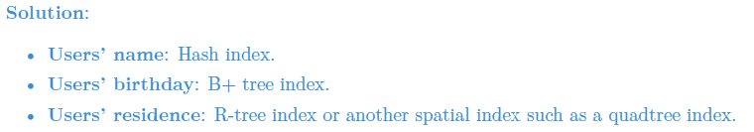
Question 10 - Solution
What indices are suitable if a table is frequently used for finding records based on three criteria?
  a list of users’ name,
  a range of users’ birthday
  a spatial region covering users’ residence

Slide 52
Question 11- Breakout Rooms
Review the points on indexing with B+ trees. Assume a database table has 10,000,000 records and the index is built with a B+ tree. The maximum number of children of a node, is denoted as n.
  How many steps are needed to find a record if n = 4?
  How many steps are needed to find a record if n = 100?

Slide 53
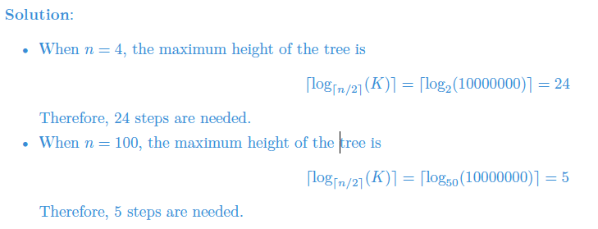
Question 11- Solution
Review the points on indexing with B+ trees. Assume a database table has 10,000,000 records and the index is built with a B+ tree. The maximum number of children of a node, is denoted as n.
  How many steps are needed to find a record if n = 4?
  How many steps are needed to find a record if n = 100?

Slide 54
Search in R-Trees
To find data items intersecting a given query point/region, do the following, starting from the root node:
  If the node is a leaf node, output the data items whose keys intersect the given query point/region.
  Else, for each child of the current node whose bounding box intersects the query point/region, recursively search the child.
Can be very inefficient in worst case since multiple paths may need to be searched due to overlaps, but works acceptably in practice.

Slide 55
Nearest Neighbour in R-Trees
To find the nearest neighbour of a given query point/region, do the following, starting from the root node:
  Use a sorted priority queue of the R-tree nodes based on the minimum distance from the query
  Traverse the node that is in the top of the priority queue, and put its elements in the queue. Continue
  Stop when the top node is a data object (first NN has been found)
This algorithm is a best-first search algorithm

Slide 56
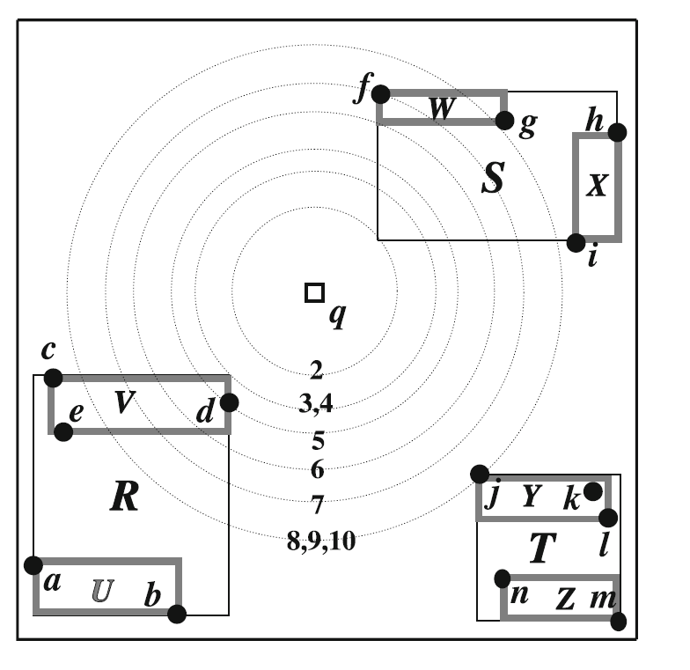
Example R-tree

Slide 57
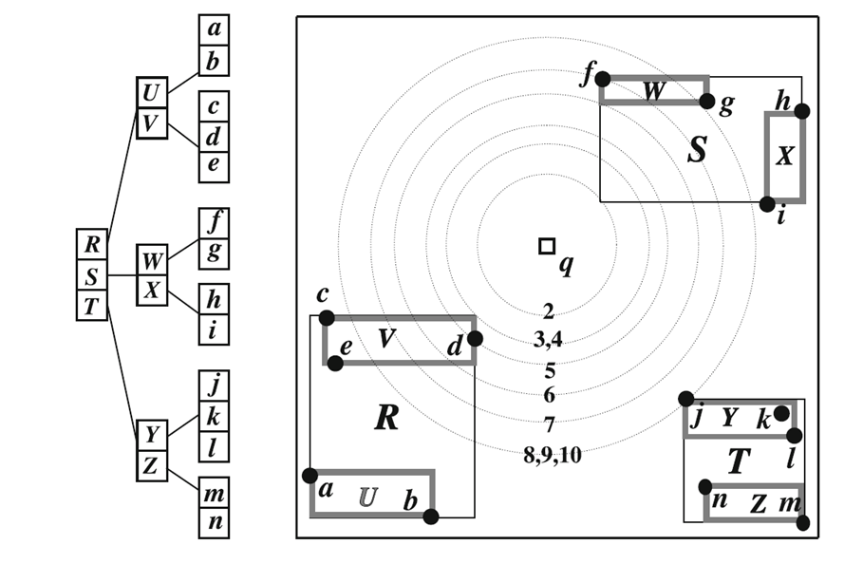
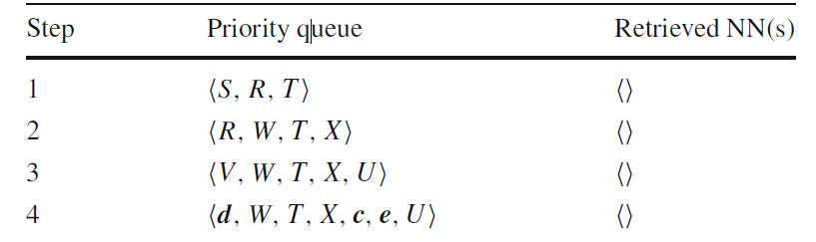
Nearest Neighbor Query on R-tree
Step 5 finds d as the first NN (using Best First search)

Slide 58
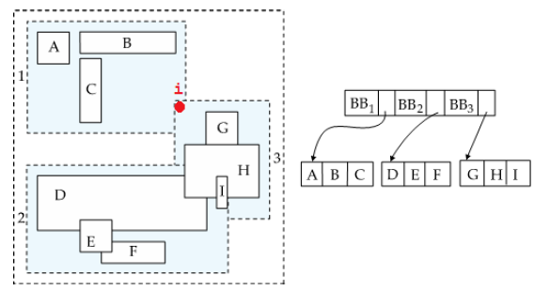
Question 12- Search the closest to “i” in R-Tree? Anything special?

Slide 59
Question 12- Solution
Solution:
In this traversal we first visit node BB1 as it overlaps with the query point, and find that object B is the closest to query point i.
The issue here is that we cannot stop at this point in the traversal as i overlaps with BB3 as well.
After investigating BB3, we figure out that G is the closest object overall.
Due to overlaps in R-tree branches two or more branches of an R-tree need to be investigated in many query types. In addition, as each internal node represents a bounding box, thus we are not sure about the position of objects in a bounding box which may necessitate that we investigate multiple bounding boxes to determine a nearest neighbour in this case.

